Slide 1
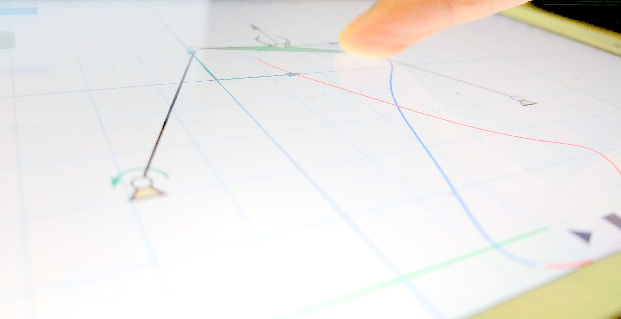
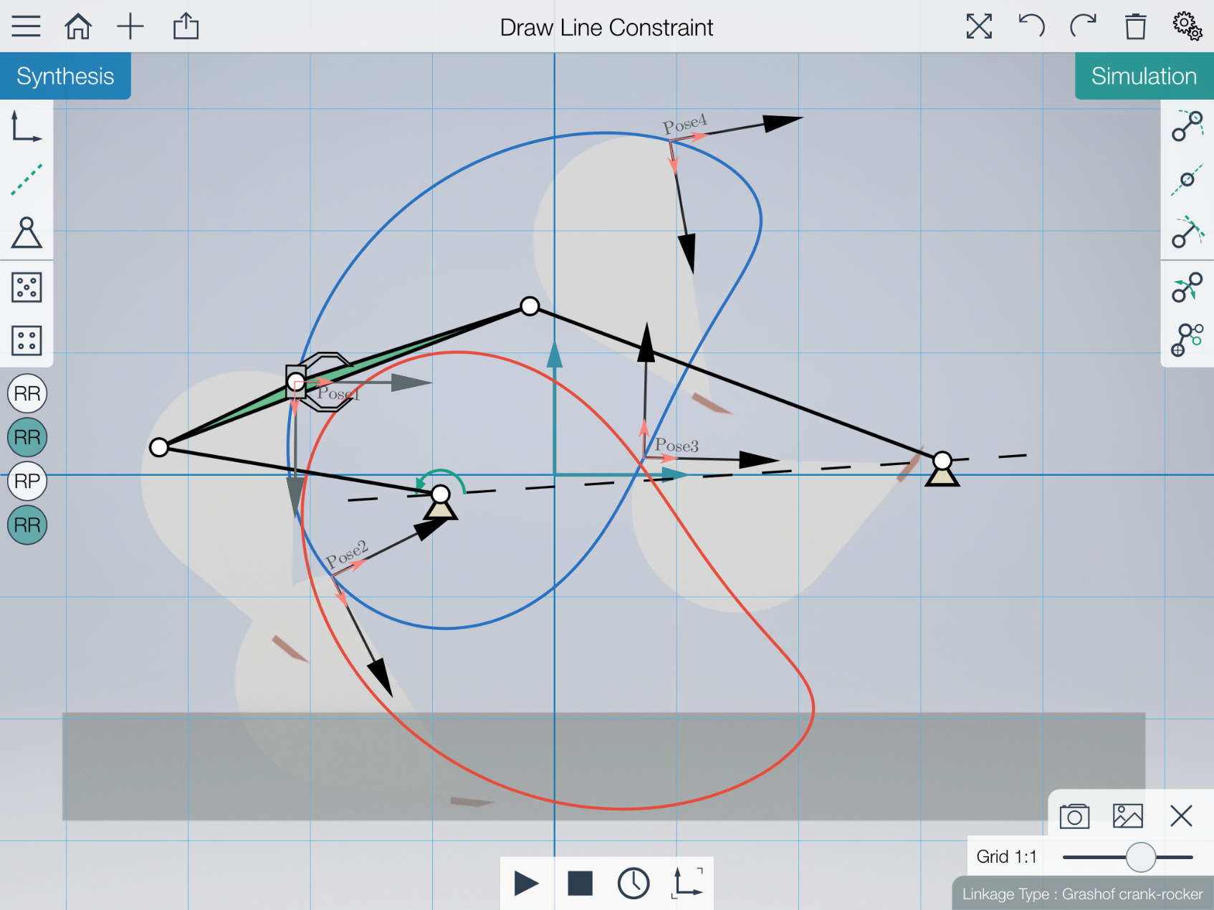
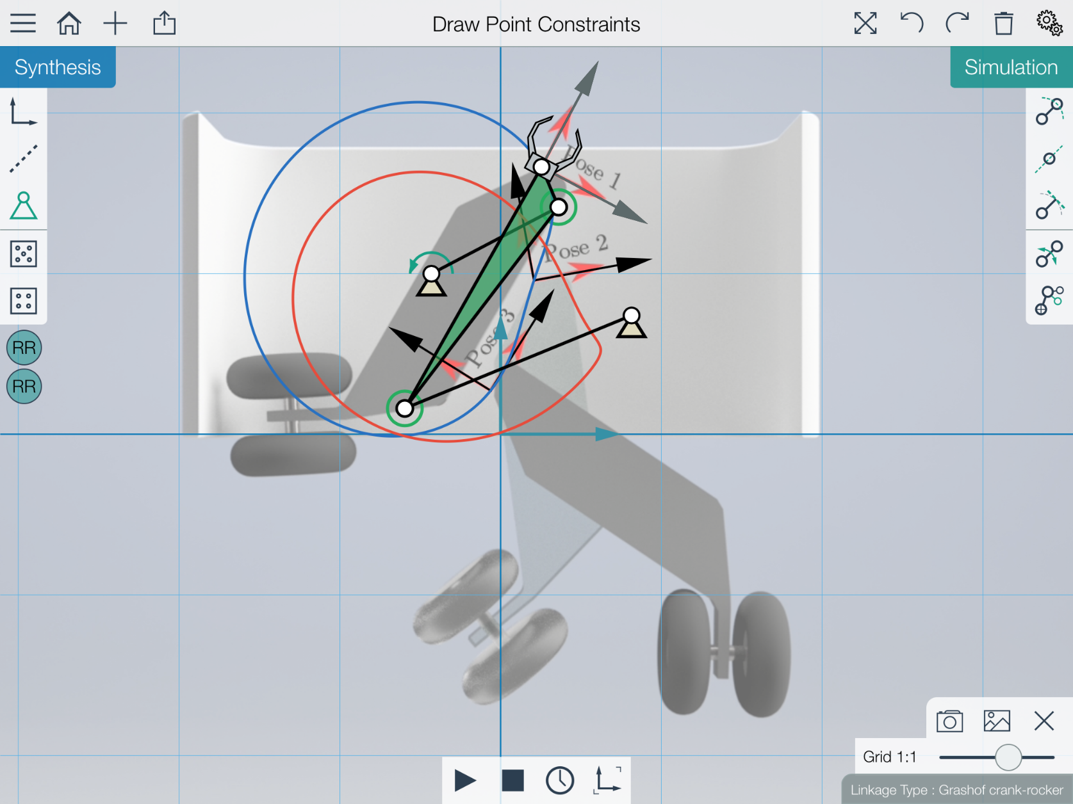
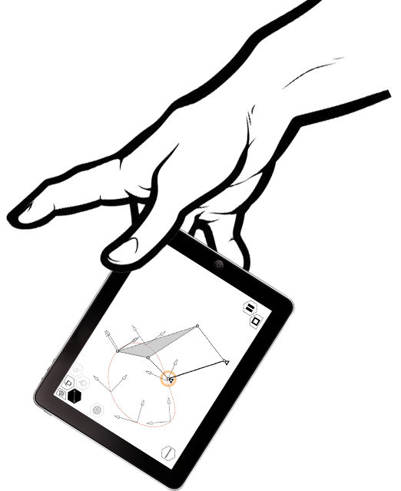
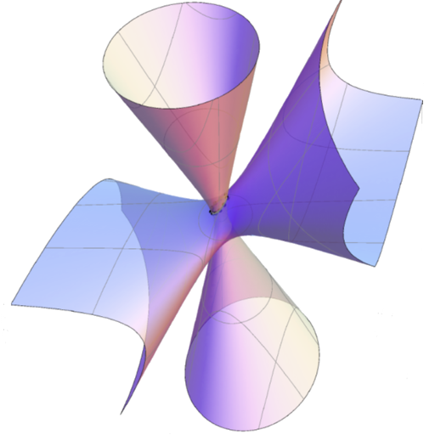
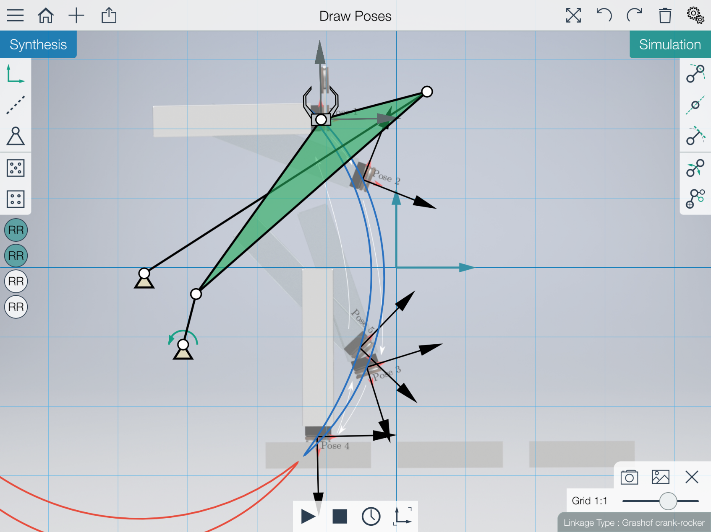
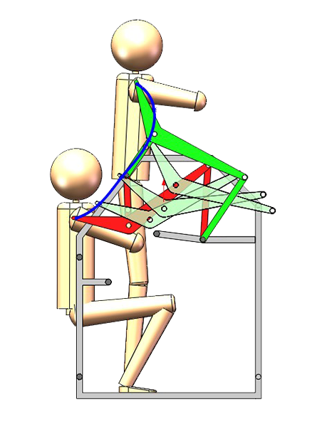
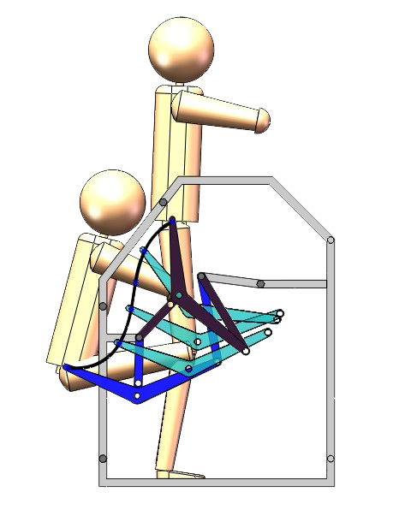
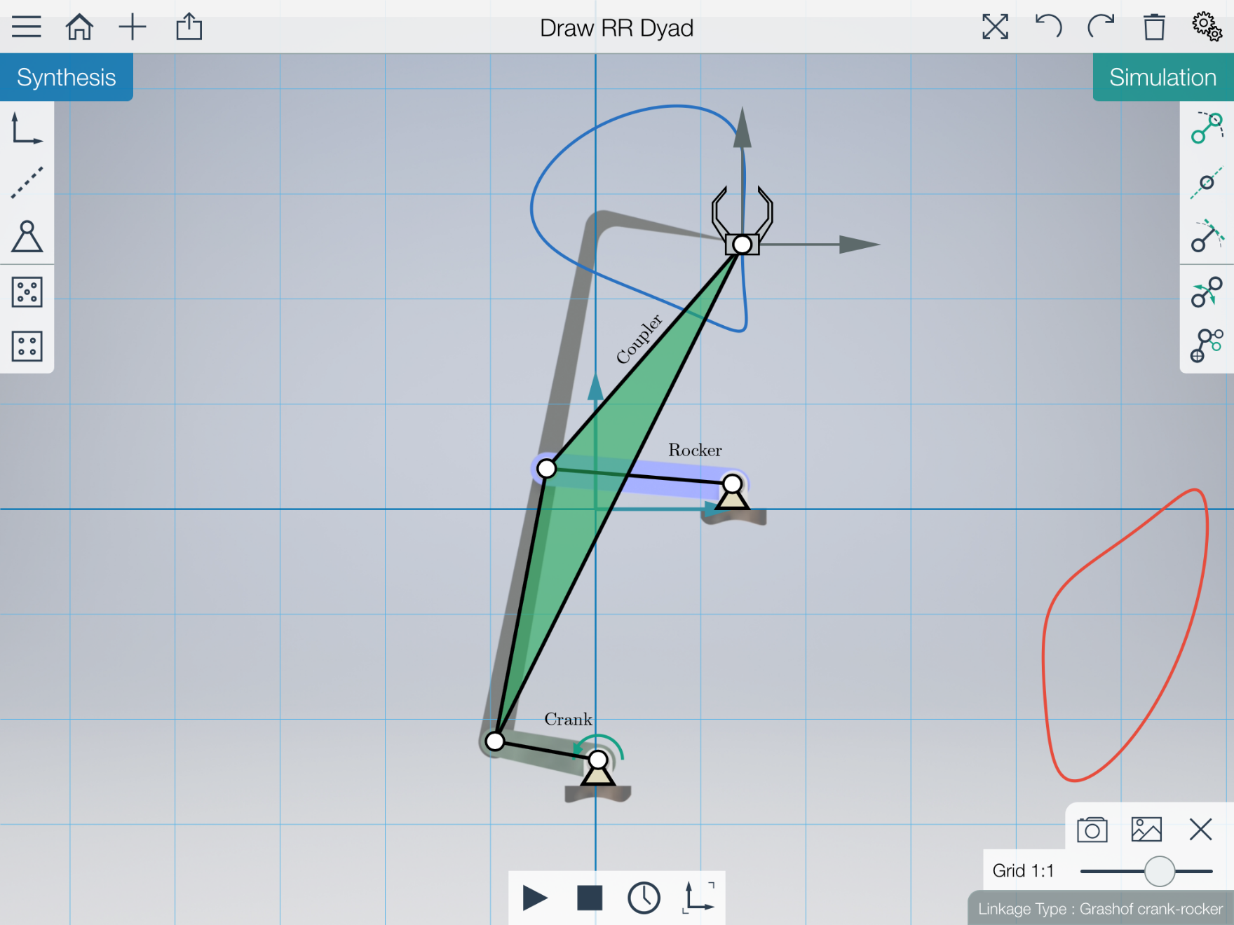
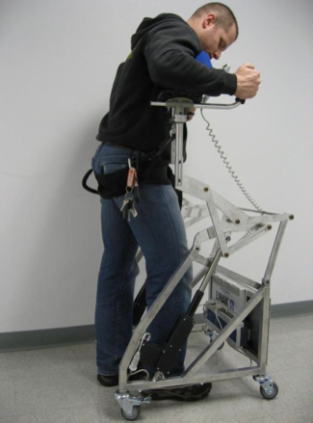
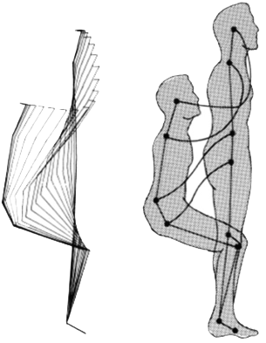
MotionGen: A Multi-touch app for Kinematic Design and Simulation of Linkages
Anurag Purwar, Jeffrey Ge, Mechanical Engineering
Synthesis Features
Task Driven Approach for simultaneous type and dimension synthesis*
Synthesizes a planar four-bar linkage for Five or less Precision Poses
Point and line constraints for fixed and moving pivots
Reinterpretation of RR dyad
Real-time tolerance based search for Circuit, branch and order defect Free Solution.
Excavator: Four Poses with Line Constraint for Fixed Pivots
Landing Gear Mechanism:
Three Poses with Moving Pivot Constraints
Synthesis
Simulation
Simulation and other Features
Animation
Coupler Point Path Simulation
Linkage Classification
Image Import
Export in PDF and XML
Imports .XML
Stamping Mechanism: Five Exact Poses
Prototype **
Shoulder lifting Motion
Hip lifting Motion
Real life device design
Simulation of Planar Four-Bar Film Advancing Mechanism
Sit-to-Stand Motion
A Novel Ge, Q. J., Zhao, P., and Purwar, A., 2013, “A Task Driven Approach to Unified Synthesis of Planar Four-bar Linkages using Algebraic Fitting of a Pencil of G manifolds”, ASME 2013 International Design Engineering Technical Conferences and Computers and Information in Engineering Conference, dETC2013-12977.
** Portable Six-Bar Apparatus For Lifting, Lowering and Self-Propelled Transit”, Inventors: Anurag Purwar et al, US Patent Application No. 12/868,446, 2010, awarded

